Slide 1
Lecture 3 – Constructor
Programming
Principles and Practice Using C++
Shengfa Wang
sfwang@dlut.edu.cn

Slide 2
Classes & Objects
The class is the cornerstone of C++
  It gives the C++ its identity from C
  It makes possible encapsulation, data hiding and inheritance
Class:
  Consists of both data and methods
  Defines properties and behavior of a set of entities
Object:
  An instantiation of a class
  A variable identified by a unique name
Notes:
Aim of class: a) provide the programmer with a tool for creating new types that can be used as conveniently as the built-in types (like float) b) user-defined type
why? Separate the incidental details of the implementation from the properties essential to the correct use of it
2. Derived class, templates: organizing related classes that allow the programmer to take advantage of their relationships.

Slide 3
Objects
OOP uses objects as its fundamental building blocks.
Objects are the basic run-time entities in an object-oriented system.
Every object is associated with data and functions which define meaningful operations on that object.
Object is a real world existing entity.

Slide 4


Class Specification
Syntax:
class class_name
{
};
A class definition begins with the keyword class.
The body of the class is contained within a set of braces, { } ; (notice the semi-colon).
Any valid identifier
Data members
Members functions
Class body (data member + methods)

Slide 5
Class Specification
class Clock
{
int hour；
int minute;
int second;
void setClock(int h, int m, int s);
void showClock ( );
};
Class Specification
Data Members or Properties of Clock
Members Functions or Behaviors of Clock
Private by default

Slide 6
Access Control
Access Specifiers in C++ class defines the access control rules.
Public:
  elements of class are accessible from outside of class.
Private:
  restricts access to these functions and data members to this class alone. (as default)
Protected:
  restricts access to these functions and data member to this class and its children. (Children are classes derived from the current class)
Notes:
These access specifiers are used to set boundaries for availability of members of class like data members or member functions.

Slide 7
int main ()
{
Rectangle rect; rect.set_values (3,4); cout << "area: “<< rect.area(); return 0;
}
#include <iostream>
using namespace std;
class Rectangle {
int width, height;
public:
void set_values (int x,int y){
width = x;
height = y;
}
int area(){
return width*height;
}
};
Notes:
Data Members width and height have private access (remember that if nothing else is specified, all members of a class defined with keyword class have private access). By declaring them private, access from outside the class is not allowed. But we could access the private members from inside the class. This makes sense, since we have already defined a member function to set values for those members within the object: the member function set_values. Therefore, the rest of the program does not need to have direct access to them. Perhaps in a so simple example as this, it is difficult to see how restricting access to these variables may be useful, but in greater projects it may be very important that values cannot be modified in an unexpected way (unexpected from the point of view of the object).

Slide 8

Define a member function outside the class itself
#include <iostream>
using namespace std;
class Rectangle {
int width, height;
public:
void set_values (int,int);
int area() {return width*height;}
};
void Rectangle::set_values (int x, int y)
{
width = x;
height = y;
}
The scope operator (::) specifies the class to which the member being declared belongs, granting exactly the same scope properties as if this function definition was directly included within the class definition.

Slide 9
Difference
The only difference between defining a member function completely within the class definition and defining it later outside the class
  In the first case, the function is automatically considered an inline member function by the compiler.
  In the second, it is a normal (not-inline) class member function. This causes no differences in behavior, but only on possible compiler optimizations.

Slide 10
Inline Functions with Class
When to use Inline Function…..?
If a function is very small.
If the time spent to function call is more than the function body execution time.
If function is called frequently.
If a fully developed & tested program is running slowly.

Slide 11
Practice
The class is Rectangle, which contains four members: two data members of type int (member width and member height) with private access and two member functions with public access: the functions set_values and area, of which for now we have only included their declaration, but not their definition.
There are two objects, objects: rect and rectb.
Find area of rect and reatb, and print them out.

Slide 12
Constructors
C++ requires that every class have a constructor
The constructor is responsible for initializing objects automatically whenever they are declared.
The programmer has the option to provide his/her own constructors, which get called whenever a new object is declared. Otherwise, the compiler provides a default constructor
But what is a constructor?

Slide 13
Constructors
The constructor is like member function
  the same name of class
  have no return type, not even void
  should be declared in public section
  it can be overloaded
  its arguments can be defaulted
  Default constructor (defaults to: nothing)
    No default if any other constructor is declared
  Copy constructor (defaults to: copy the member)
    Fraction f1，f2；
    Fraction f3= f1; // Copy constructor.
  Copy assignment (defaults to: copy the members)
    f2 = f3; // Not a copy, but assignment operator.

Slide 14


Constructors
Example:
class student
{ int st_id;
public:
student()
{
st_id=0;
}
};
Synatax:
class class_name
{
public:
class_name();
};

Slide 15



Constructors
How to call this special function…?
class student
{
int st_id;
public:
student()
{
st_id=0;
}
};
int main()
{
student st;
…………
…………
};

Slide 16
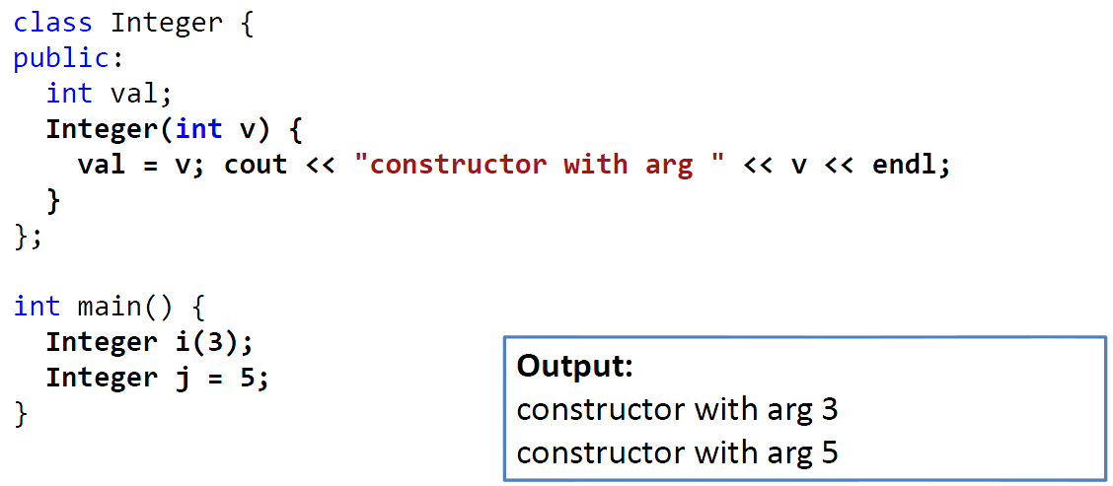

Constructors
Can accept parameters

Slide 17
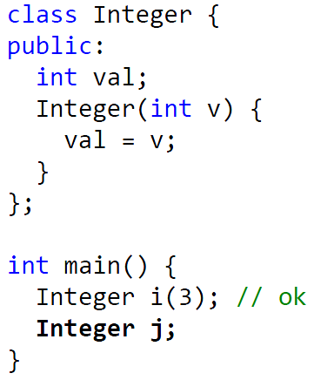
Constructors
If a constructor with parameters is defined, the default constructor is no longer available
// compiling failed

Slide 18
Types of Constructors
Overloaded constructors
Constructors with default argument
Copy constructors

Slide 19
Function Overloading
In c++ function overloading enables several functions
Of same name
Of different number of parameters
Of different types of parameters
But the return type is not considered!

Slide 20
Square function
1. int square(int x)
{ return x*x; }
2. double square(double y)
{ return y*y;}
3. float square(float z)
{ return z*z;}
4. double square(float z) (no overloading according to 3)
{ return z*z;}
Notes:
重载返回值可以相同也可以不同，关键看参数列表。

Slide 21

Parameterized Constructors
class Addition
{
int num1;
int num2;
int res;
public:
Addition(int a, int b); // constructor
void add( );
void print();
};
Constructor with parameters B’Coz it’s also a function!

Slide 22

Overloaded Constructors
class Addition
{
int num1,num2,res;
float num3, num4, f_res;
public:
Addition(int a, int b); // int constructor
Addition(float m, float n); //float constructor
void add_int( );
void add_float();
void print();
};
Overloaded Constructor with parameters B’Coz they are also functions!

Slide 23
Constructors with Default Argument
class Addition
{
int num1;
int num2;
int res;
public:
Addition(int a, int b=0); // constructor
void add( );
void print();
};
Constructor with default parameter.

Slide 24

Copy Constructor
class code
{
int id;
public:
code() //constructor
{ id=100;}
code(code &obj) // constructor
{
id=obj.id;
}
};

Slide 25
Destructor
Destructor declaration
~classname();
Destructor calls
  When an automatic variable (object) reaches the end of its lifetime.
  When deleting an object created by the new operator.
  Called by the inverse order of being constructed
A class has one and only one destructor.
  Cannot overload the destructor.
  Can re-write the destructor.
class Time
{public:
Time(int ,int ,int );
~ Time();
private:
int hour; int min; int sec;
};
void fun()
{
Time t(10,1,1);
Time *pt = new Time(1,1,1);
}

Slide 26
new and delete?
void *operator new(size_t); //allocate an object
void *operator delete(void *); //free an object
void *operator new[](size_t); //allocate an array
void *operator delete[](void *); //free an array
new/delete
new[]/delete[]
is always OK! But there are more choices ~~

Slide 27
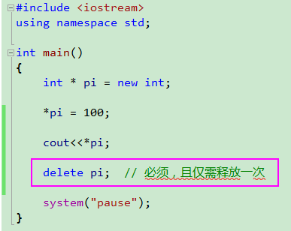
new and delete?

Slide 28
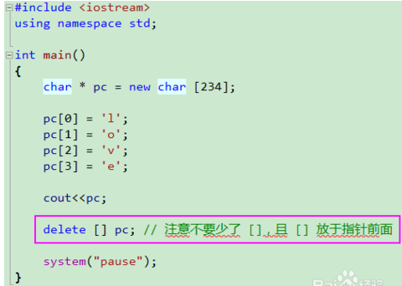
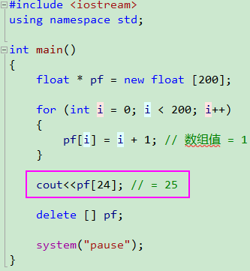
new and delete?

Slide 29
new and delete?
class A
{
char *m_cBuffer;
int m_nLen;
public:
A(){ m_cBuffer = new char[m_nLen]; }
~A() { delete [] m_cBuffer; }
};
A *a = new A[10];
delete a; //仅释放了a指针指向的全部内存空间 但是只调用了a[0]对象的析构函数 剩下的从a[1]到a[9]这9个用户自行分配的m_cBuffer对应内存空间将不能释放, 从而造成内存泄漏
delete [] a; //释放了a指针指向的全部内存空间 并且调用使用类对象的析构函数释放用户自己分配内存空间

Slide 30
Constructor and Destructor
class Point
{
private:
double x, y;
char *name;
public:
Point(char *n=Null, double x=0, double y=0);
~Point();
void disp( );
};
Point::Point (char *n, double a, double b) {
x = a; y = b;
if(n) {
name=new char[strlen(n)+1];
strcpy(name,n);
}
else{
name=new char[8];
strcpy(name,"no name");
}
cout<<name<<" constructing"<<endl;
}
Default parameter
Notes:
先不讲new delet

Slide 31
Constructor and Destructor
Point::~Point(){
cout<<name<<" destructing"<<endl;
delete [] name;
}
void Point::disp( ){ cout<<name<<":"<<x<<","<<y<<endl; }
void main(){
Point p1("home",1.0,2.0);
Point p2(“school”, 1.0,2.0);
Point p3;
cout<<“p1=”;
p1.disp();
cout<<"p2=";
p2.disp();
cout<<"p3=";
p3.disp();
}
home constructing
school constructing
no name constructing
p1=home:1,2
p2=school:1,2
p3=no name:0,0
no name destructing
school destructing
home destructing

Slide 32
Copy Constructor
Declaring and Defining
  A copy constructor always has one (1) parameter, the original object.
  Must be the same type as the object being copied to.
  Always passed by reference (must be because to pass by value would invoke the copy constructor).
  Copy constructor not required
  Fraction (Fraction &f);
  Timer (Timer & t);
Notes:
所以绕了那么大的弯子，就是想说明拷贝构造函数的参数使用引用类型不是为了减少一次内存拷贝， 而是避免拷贝构造函数无限制的递归下去。

Slide 33
Copy Constructor
Examples
Fraction f1, f2(3,4)
Fraction f3 = f2; // Copy constructor.
Fraction f4(f2); // Copy constructor.
f1 = f2; // Not a copy, but assignment operator.

Slide 34
What happens?
Copy constructor (default--shallow)
Assignment (default--shallow)
Notes:
What we need to think about is what happens whenever we assign one object to another object, whenever we copy an object to another object, or whenever we delete an object. As it turns out, what c++ provides us by default asscociated with these operations which are assignment, copying and deleting is often sufficient, but there are some cases which are not sufficient, therefore we have tried overloaded assignment. Tried copy constructor, or destructor.

Slide 35
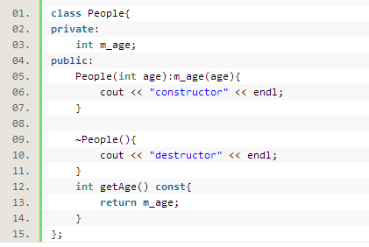

Copy Constructor
// main
Notes:
main

Slide 36
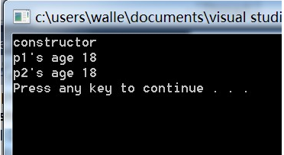
Copy Constructor
// main
Notes:
main

Slide 37
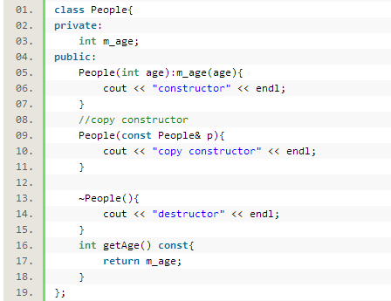
Copy Constructor
// main
Notes:
main

Slide 38
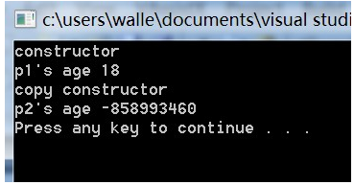
Copy Constructor
// main
Notes:
main

Slide 39
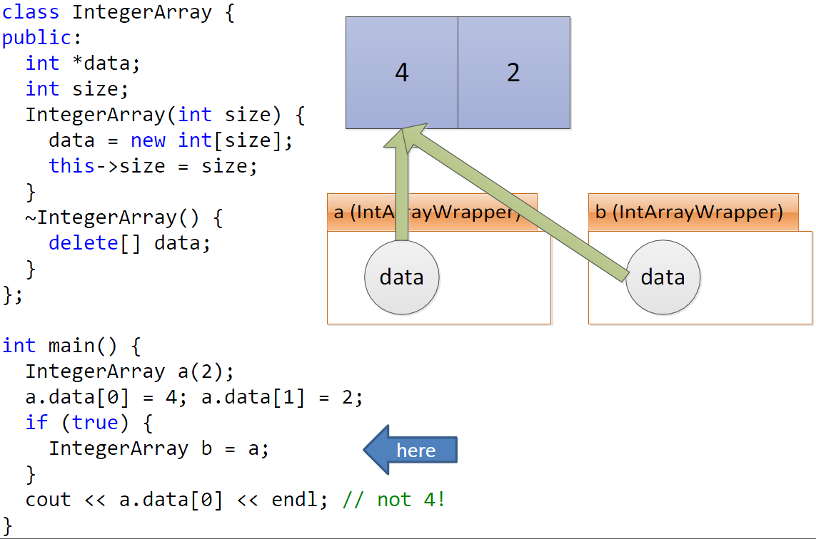
Default copy constructor copies fields

Slide 40
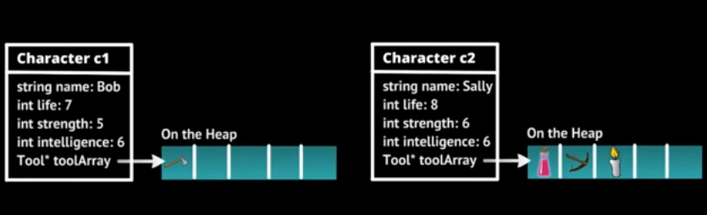
Notes:
Lets we have this c1 and c2 again,

Slide 41
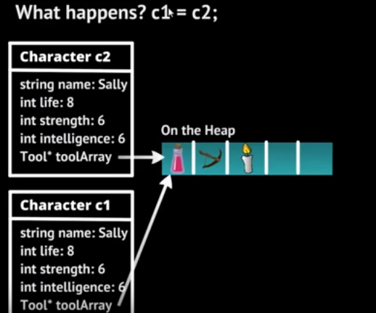
Shallow copy
Notes:
Let go back to our assignment operation. So what happens now whenever we do this assignment of c2 to c1, all the data member other than the case for the tool pointer, they all get assigned over, all the stuff in c2 is copied over here to c1.
But the problem is that is this particular pointer here able to reference things out on the heap. So we can imagine to create a new tool array out on the heap, and whenever that occurs what is actually get,ting copied here is exactly what stored in that tool pointer , which is an address. So there is address is being copied. So we end up getting the address in c2 whatever their adress maybe for the space out here on the heap.
So c1 and c2 for the tool array, they referece in the exact same array out here on the heap. And this is what we call shallow copy.
In order to avoid doing a shallow copy,

Slide 42
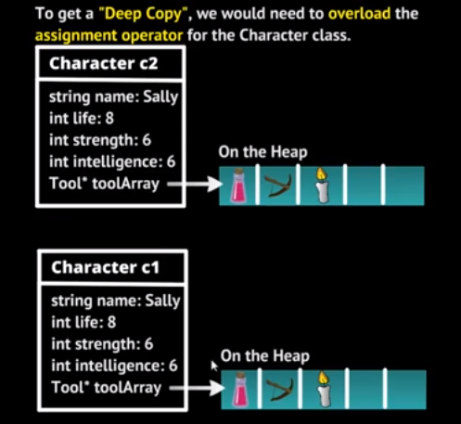
Deep copy
Notes:
In order to avoid doing a shallow copy, this is where we need to have an overloaded assignment operator. In this case we need to overload the assignment operator for the character class, then we end up with both c1 and c2 have in their own respective copies at this array.
And at that point, there characters who go forward and have difference values or different tools for their tool array.
And this is what we would like to happen.

Slide 43
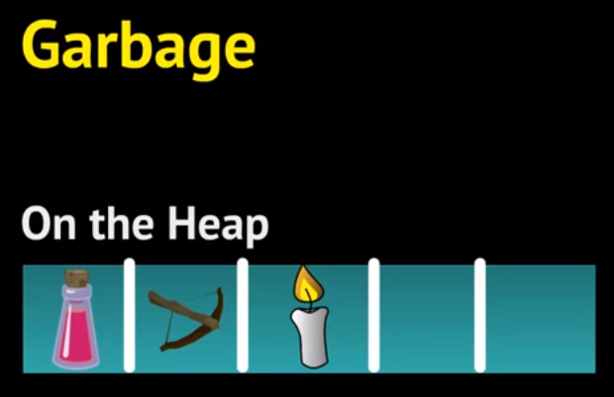

Slide 44
Deep Copy
In our previous cases, we learnt DMA(dynamic memory allocation)
  If you need memory, you new some
  If you don’t want them anymore, you should delete them, and the O/S will recycle them
We know a rule:
  Always pair new and delete
Otherwise, those allocated memory will never be able to be used by other programs until your program ends
Then your program might have eaten all the memories!

Slide 45
Example- overloading copy constructor
#include<iostream>
using namespace std;
class Terminator{
int* m_ptr;
public:
Terminator(int* ptr){ m_ptr=ptr; }
~Terminator(){ delete m_ptr; }
};
int main(){
int* ptr=new int;
*ptr=12345;
Terminator sally(ptr);
return 0;
}
Terminator(Terminator & another)
{
m_ptr=new int;
if (another.m_ptr){
*m_ptr=*another.m_ptr;
}
}
Terminator(Terminator & another)
{……}
Terminator bob=sally;
Notes:
****

Slide 46
Solution
#include<iostream>
using namespace std;
class Terminator{
int* m_ptr;
public:
Terminator(int* ptr){ m_ptr=ptr; }
Terminator(Terminator & another)
{
m_ptr=new int;
if (another.m_ptr){
*m_ptr=*another.m_ptr;
}
}
~Terminator(){ delete m_ptr; }
};
int main(){
int* ptr=new int;
*ptr=12345;
Terminator sally(ptr);
Terminator bob=sally;
return 0;
}

Slide 47
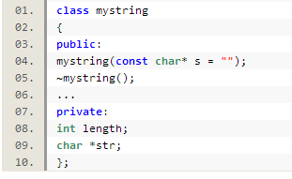

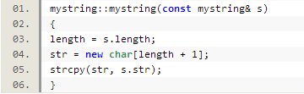
overloading copy constructor

Slide 48
overloading copy constructor
#include<iostream>
#include<string>
using namespace std;
class MyStr
{
char *name;
int id;
public:
MyStr() {
name=NULL;// is necessary
cout << "default constructor" << endl;
}
MyStr(int _id, char *_name) { //constructor
cout << "constructor" << endl;
id = _id;
name = new char[strlen(_name) + 1];
if (name!= NULL)
{strcpy_s(name, strlen(_name) + 1, _name);}
}
MyStr(const MyStr& str){
cout << "copy constructor" << endl;
id = str.id;
name = new char[strlen(str.name) + 1];
if (name!= NULL)
{strcpy_s(name, strlen(str.name) + 1, str.name);}
}
~MyStr(){delete [] name; }
};
int main(){
MyStr str1(1, "hhxx");
cout << "====================" << endl;
MyStr str2;
str2 = str1;
cout << "====================" << endl;
MyStr str3 = str2;
return 0;
}
Notes:
最后一位用于赋值‘’\0‘

Slide 49
overloading assignment operator?
#include<iostream>
using namespace std;
class Terminator{
int* m_ptr;
public:
Terminator(Terminator & another);
Terminator & operator=(const Terminator & another) ;
~Terminator(){ delete m_ptr; }
};
//overloading operator=
Terminator & Terminator ::operator=(const Terminator & another) {
… ?
return *this; // Return ref for multiple assignment
}
Notes:
你能在一个语句中连接多个赋值， 但当遇到连续赋值（即c=b=a）的情况时就会递归调用operator= 函数了，产生死循环；(b=a)=c; //这样做，b=a之后返回的是一份拷贝，再(b=a)=c的赋值作用不到b上

